Slide 1
React Hooks
Jason Monroe - 688776

Slide 2
Course Objective:
At the end this 90 min session, you will be able to
Implement React Hooks in a React Application

Slide 3
Scenario / User Story / Feature
Our Add Developer form uses old state and classes and doesn’t have any form validation. We want to implement this as well as create an edit bio feature so that we can update our bios. We can accomplish these things with React Hooks.

Slide 4
Benefits of Hooks
Use State without writing a class
Use State and stateful logic across multiple components without passing as props
More direct API for props, state, context..
Less reliance on classes
Parameterized routes

Slide 5
Key Topics
useState()
useEffect()
Context
createContext()
Context.Provider
useContext()
useParams() – Router Hook

Slide 6
useState()

Slide 7
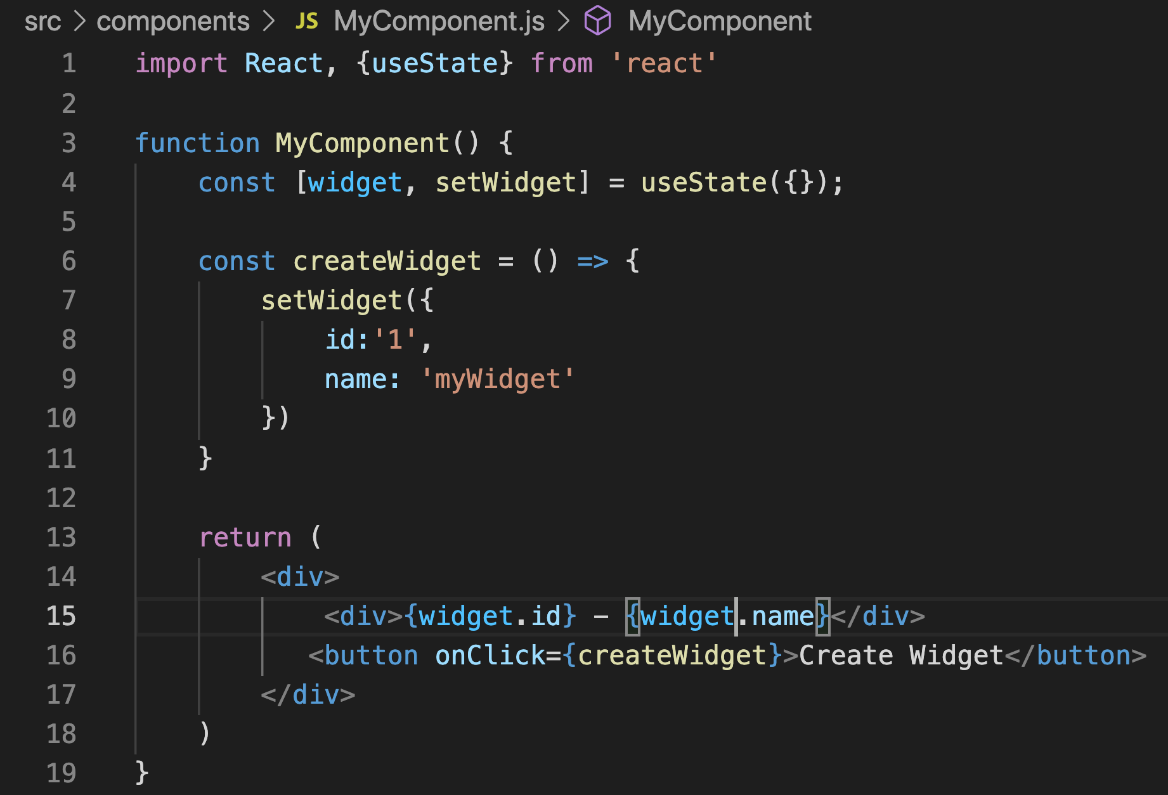
useState()
Pass initial state
Exposed from ‘react’
Returns an object and a function with ‘set’ prefix
Destructure into array
Object represents state for component
set function sets value for object/state
https://reactjs.org/docs/hooks-state.html

Slide 8
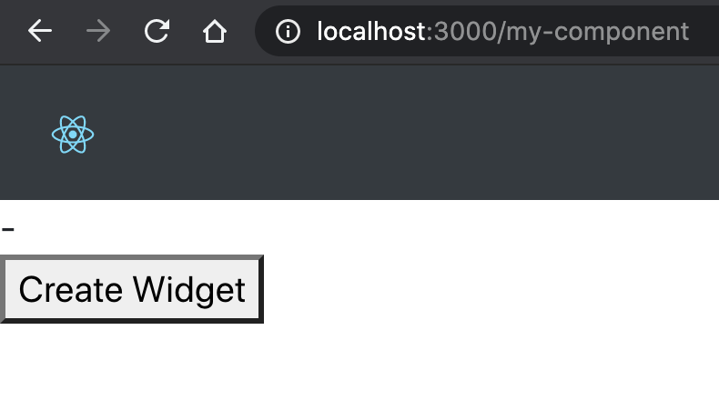
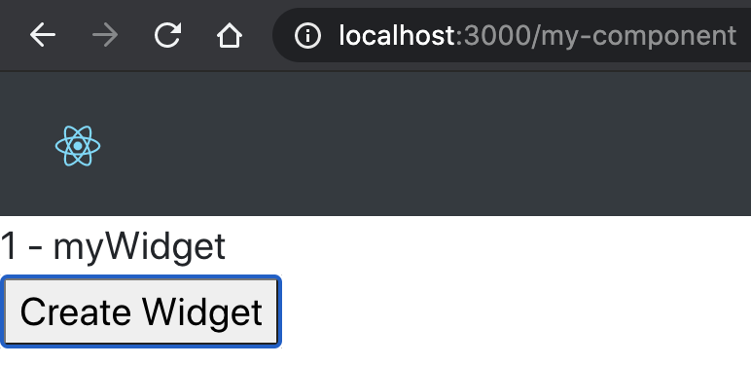
useState

Slide 9
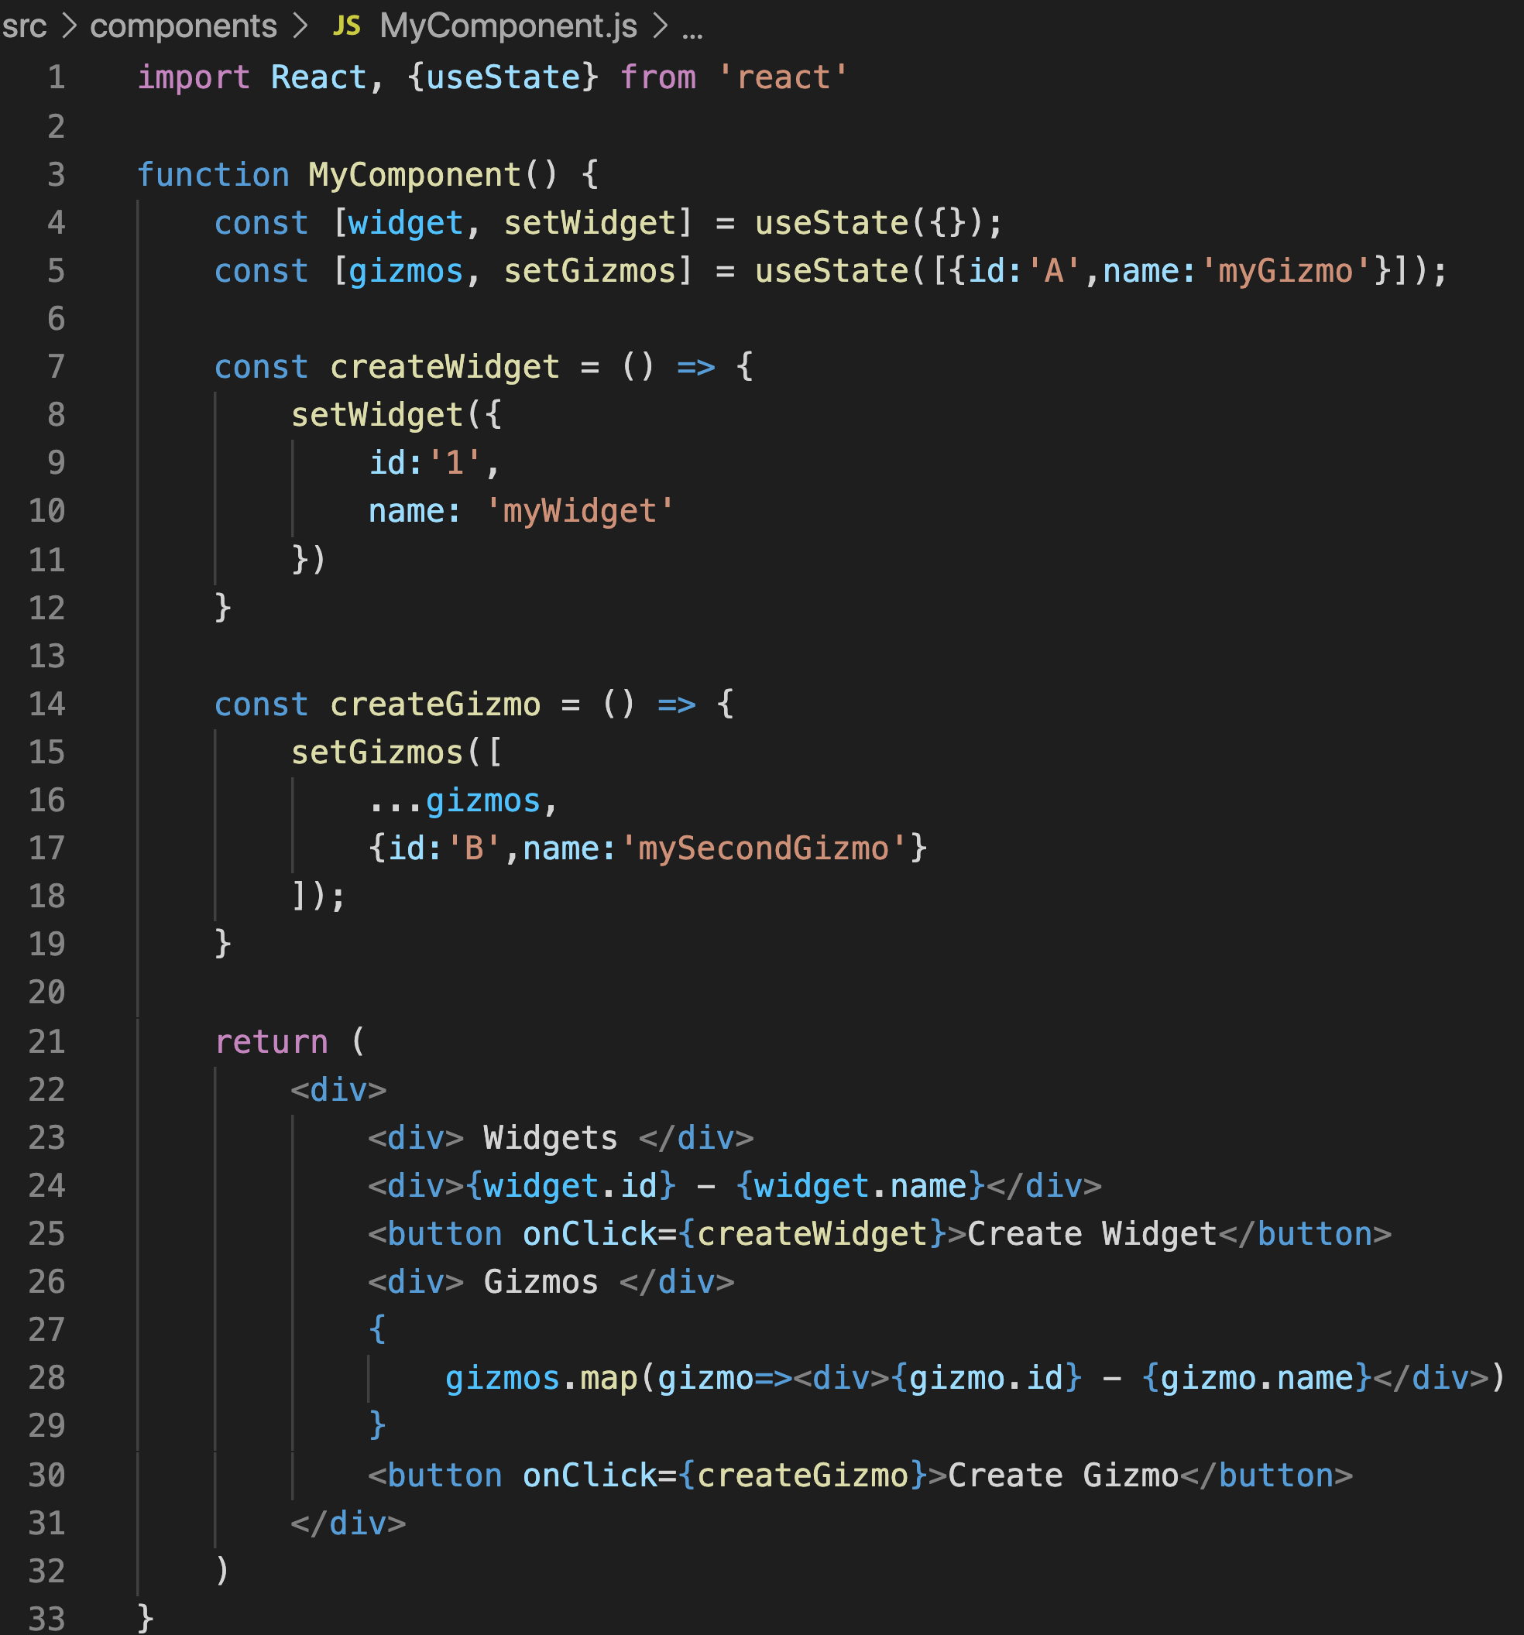
useState()
Use multiple times for different objects or an array of objects

Slide 10
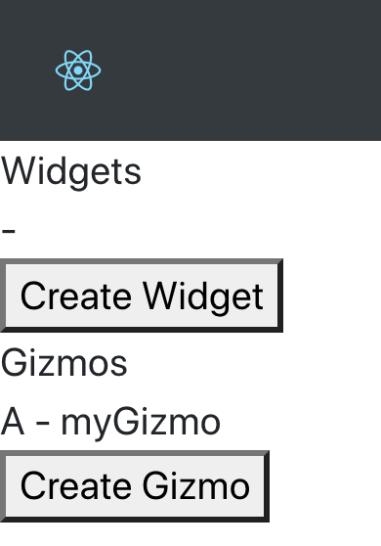
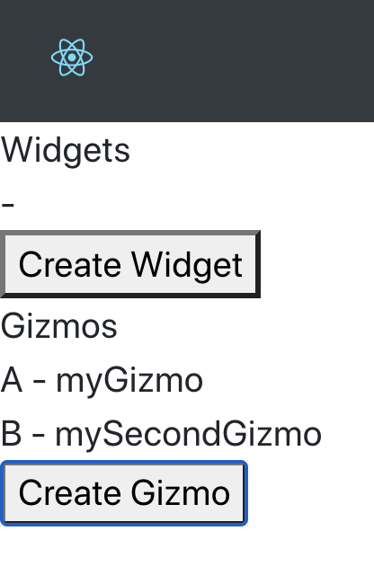
useState()

Slide 11
Practice

Slide 12

Code Along Practice – Converting AddDeveloper to useState Hook
Change AddDeveloper to a function that receives props.
Remove Constructor and replace with useState.
Remove handleChange and replace with inline state functions within input elements.
Change handleSubmit to const and remove this.state references. Change this.props.history.push to props.history.push
Update reference from this.handleState to handleState in onSubmit event handler.

Slide 13
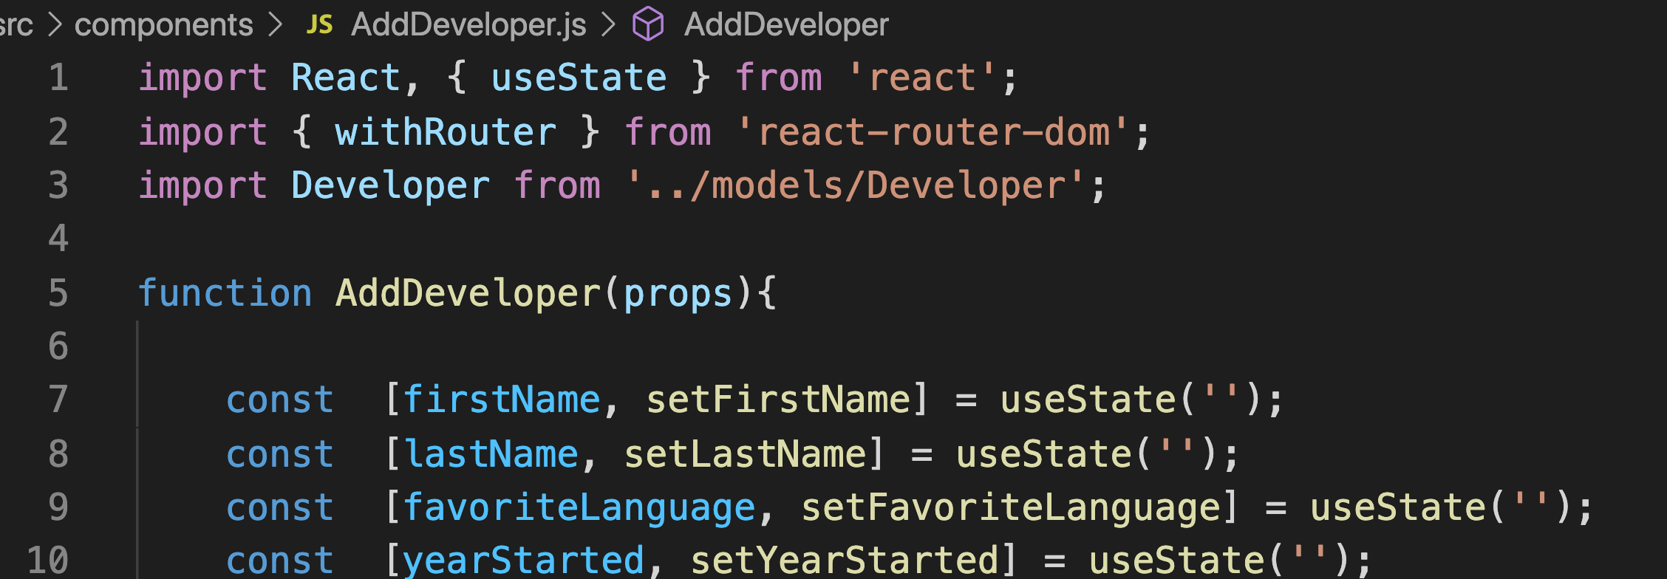
#1 and #2

Slide 14
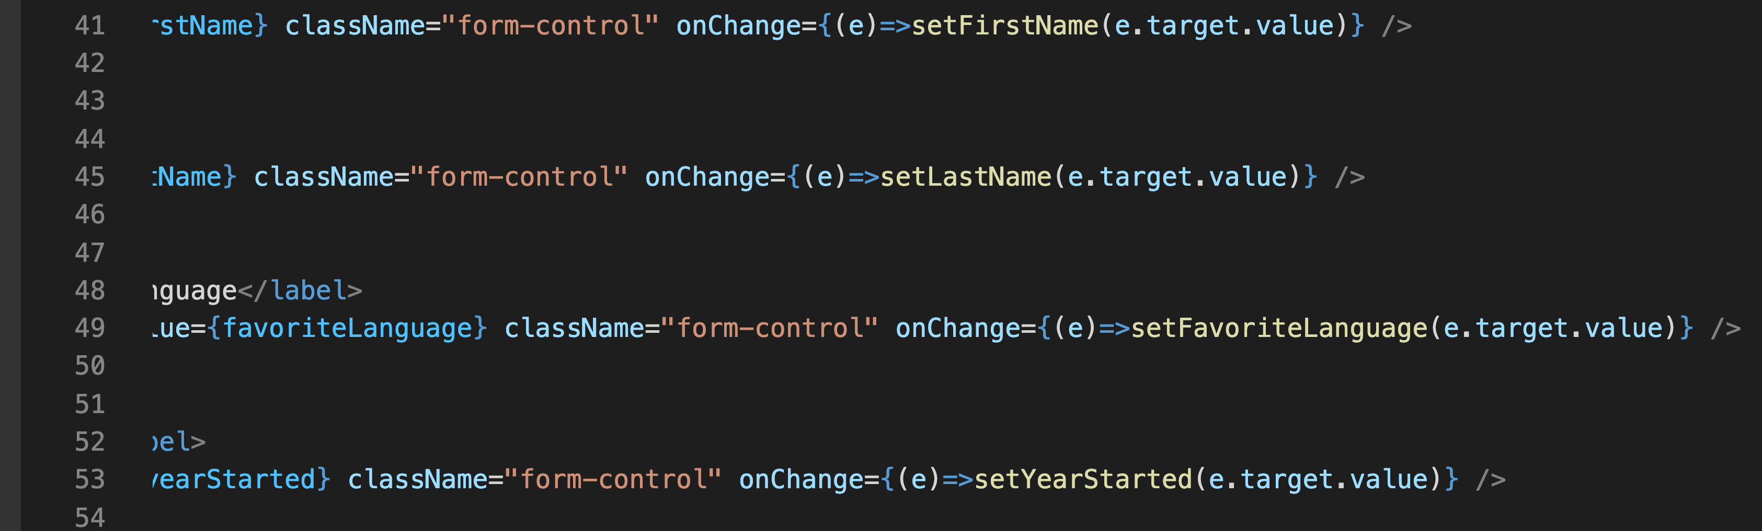
#3

Slide 15
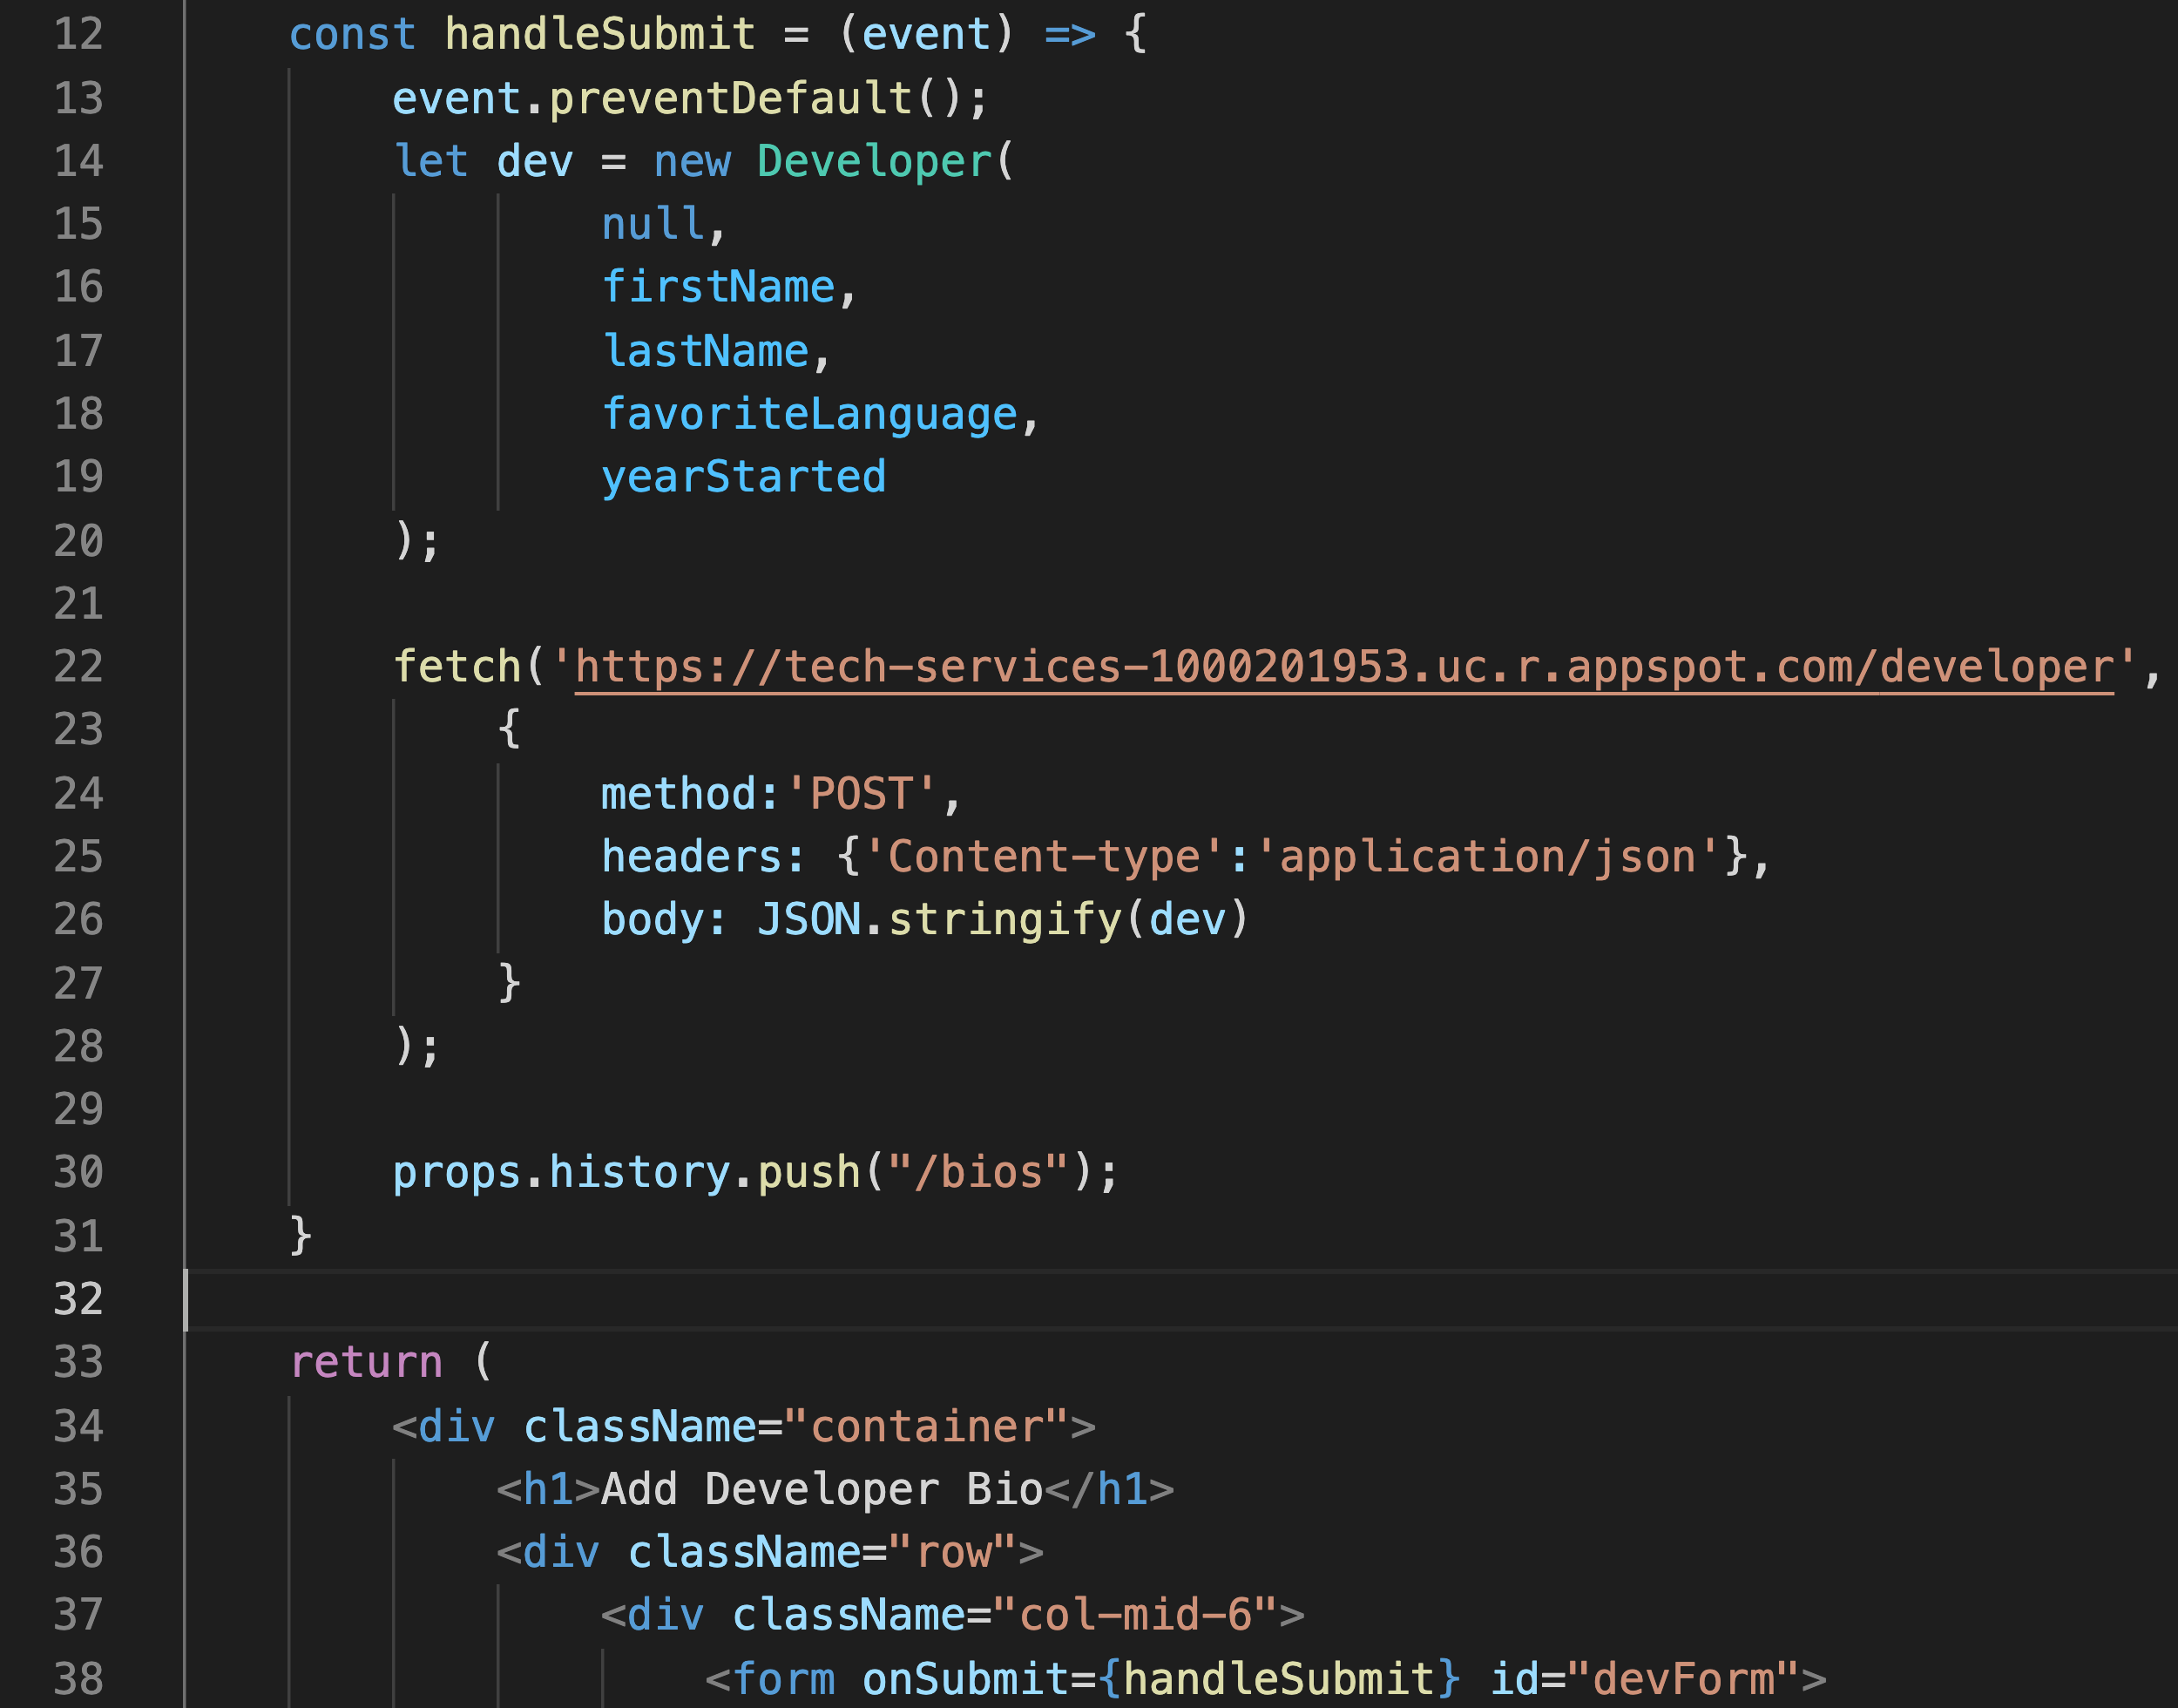
#4 and #5

Slide 16
useEffect()

Slide 17
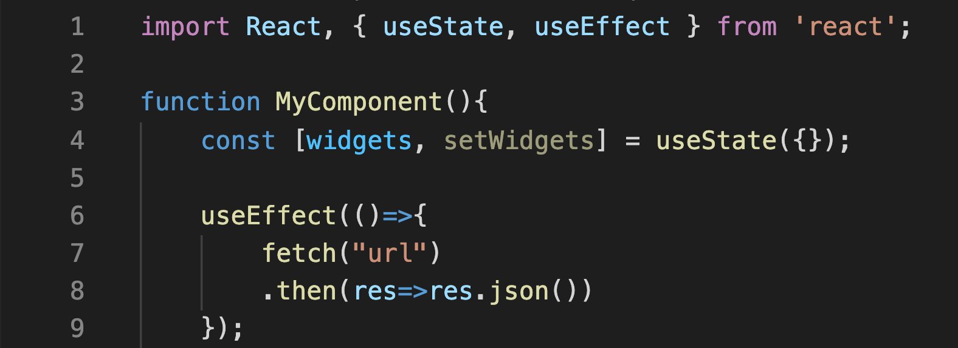
useEffect()
Think of useEffect as componentDidMount, componentDidUpdate, and componentWillUnmount combined
Called anytime the component is rendered
https://reactjs.org/docs/hooks-effect.html

Slide 18
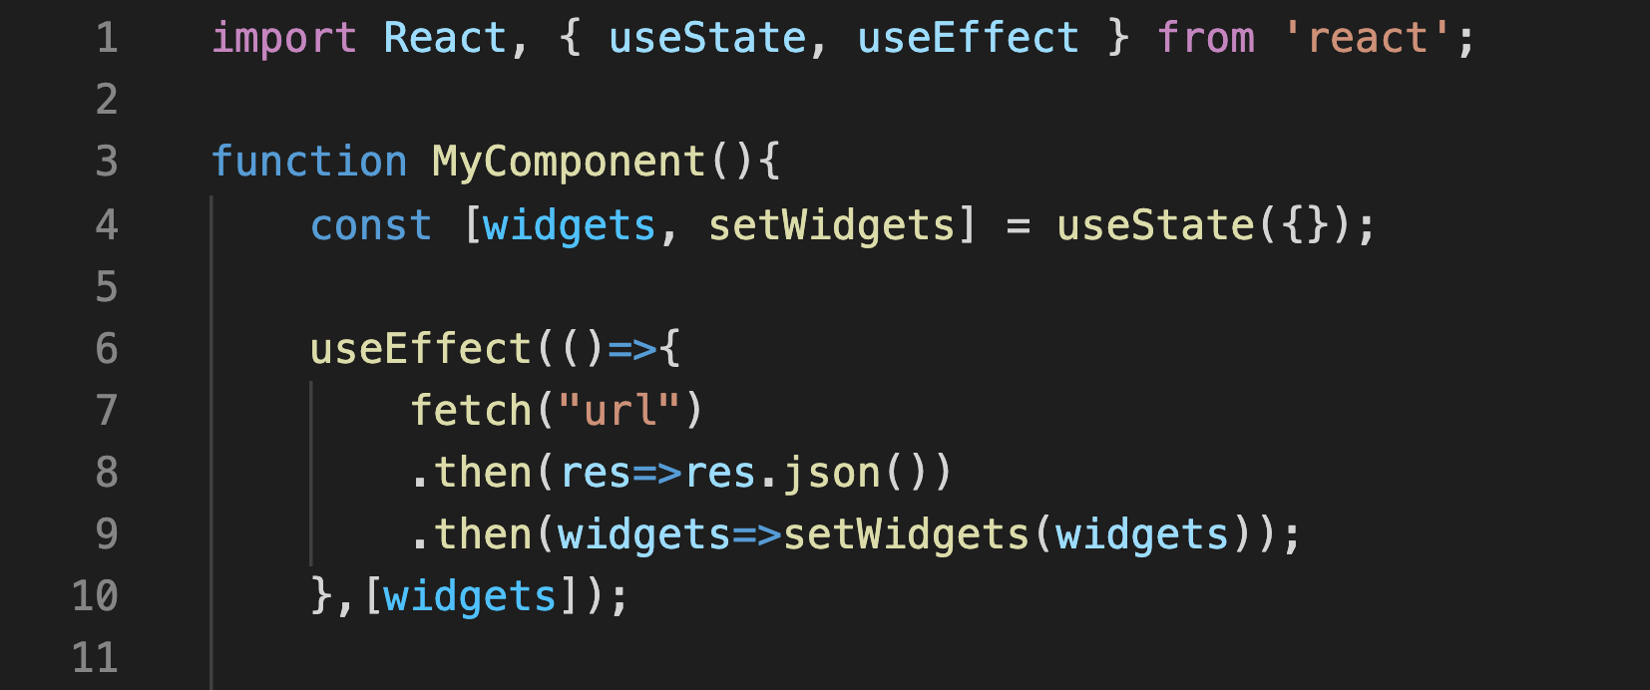
useEffect()
If state is set within useEffect, stop the infinite loop by passing the object(s) in an array as the second argument.
https://reactjs.org/docs/hooks-effect.html

Slide 19
Practice

Slide 20
Code Along Practice – useEffect Hook in AddDeveloper for Validation
Add isValidForm and isDirtyForm to state
Add useEffect function which checks each form input to see if it is ‘truthy’ in JavaScript. If all are truthy, then the form is valid. If any one of them is truthy, then the form is dirty. Set those values.
Set the submit button disabled property to the opposite of isValidForm.
Display error message if form is not valid and is dirty

Slide 21
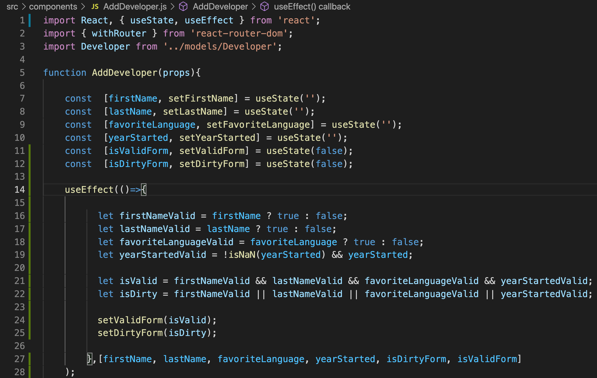
#1 and #2

Slide 22
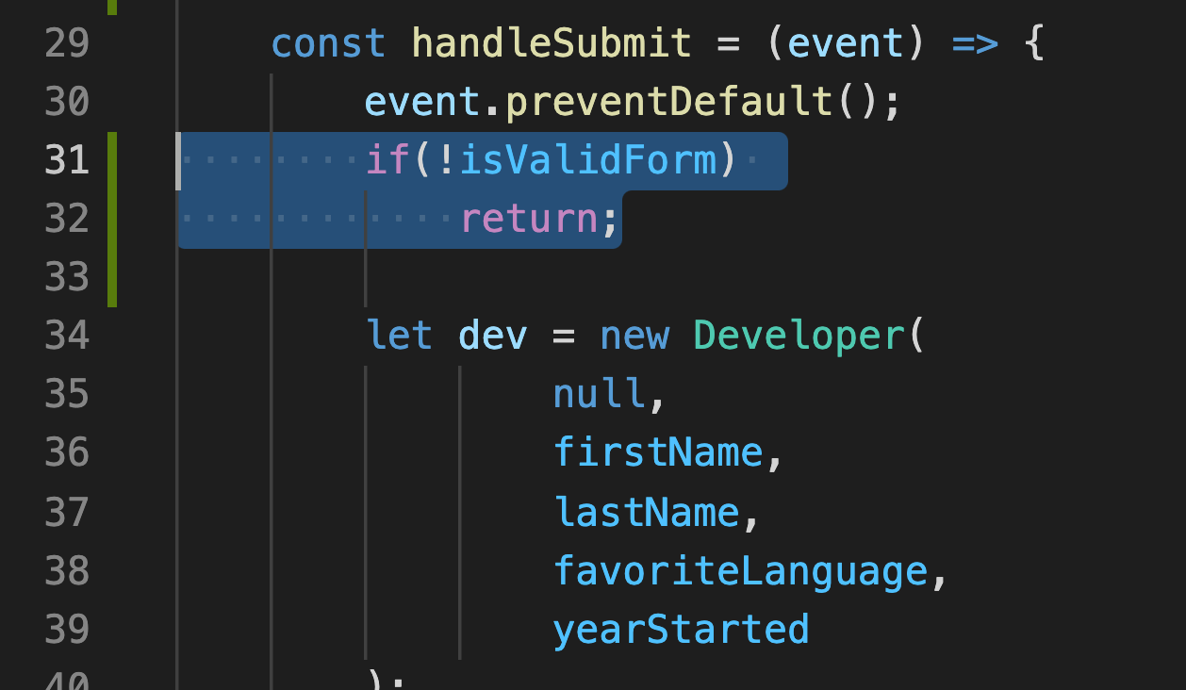
#3
#4

Slide 23
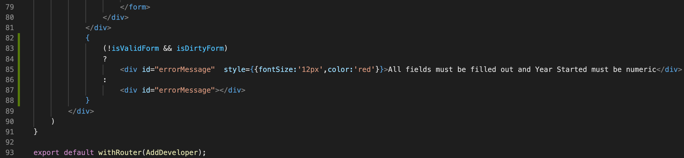
#5

Slide 24
Redirects Revisited

Slide 25
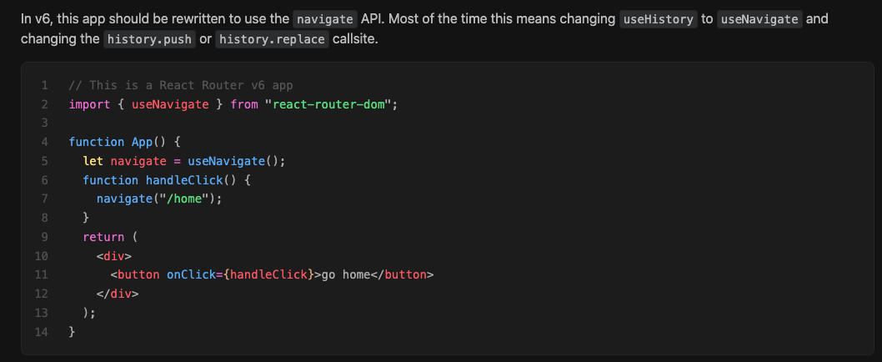
Redirecting (>v5)
HOC withRouter has been replaced with useNavigate hook.
https://reactrouter.com/docs/en/v6/upgrading/v5

Slide 26
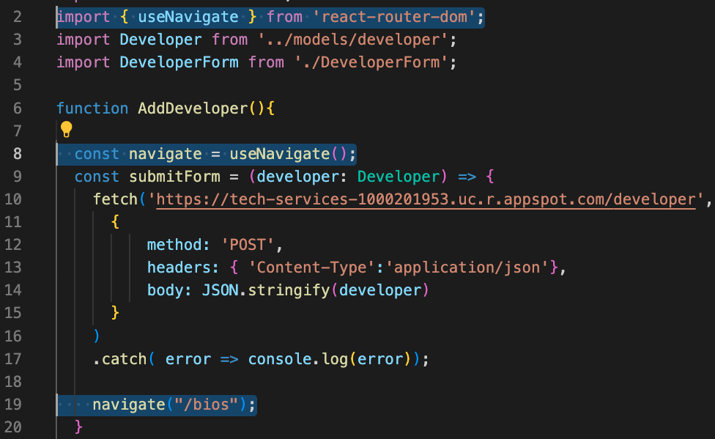
Redirecting (>=v6)

Slide 27
Context

Slide 28
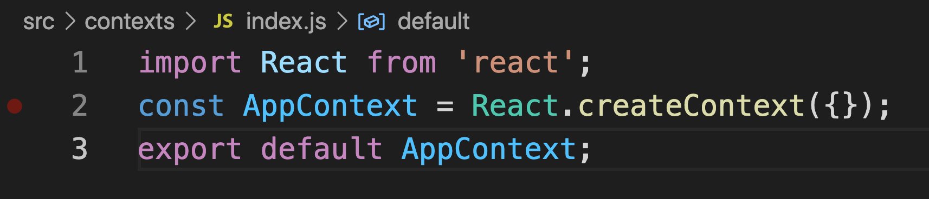
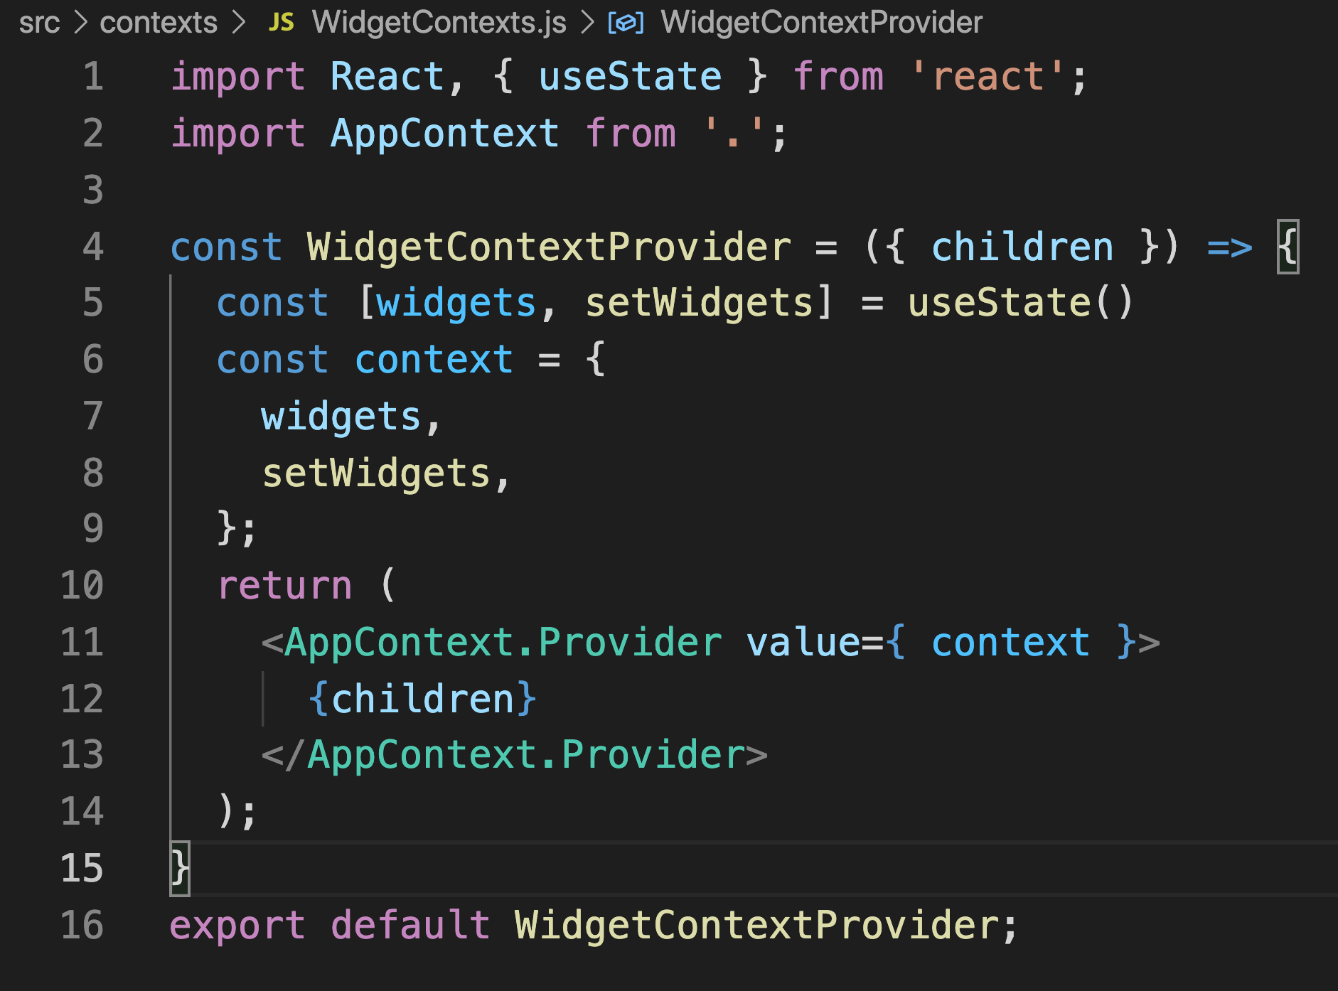
Context
Pass data through the component tree without having to pass props down manually at every level
Use React.createContext()
Provide context with Context.Provider passing value prop
Create wrapper to provide context to components that need access
https://reactjs.org/docs/context.html

Slide 29
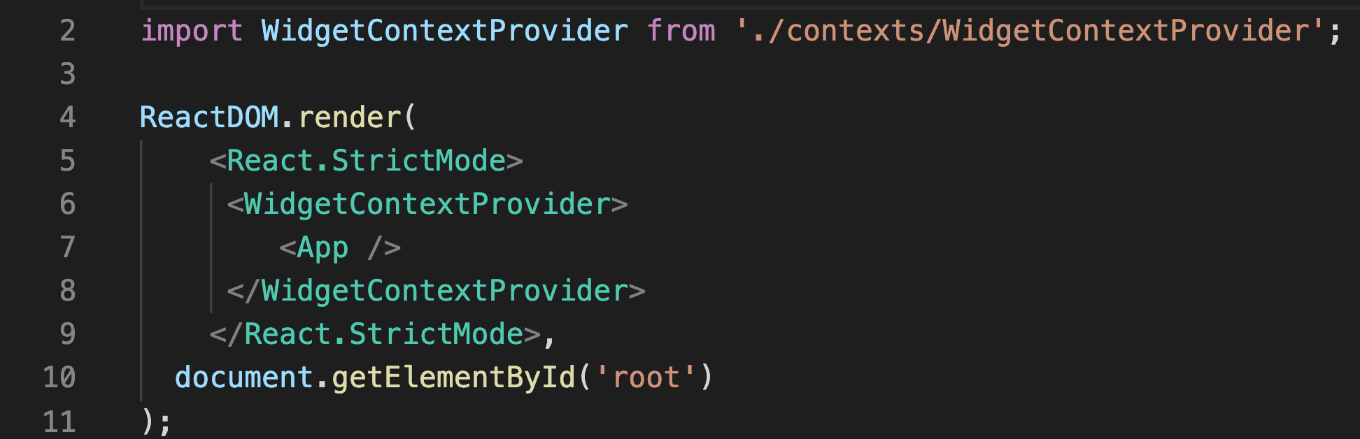
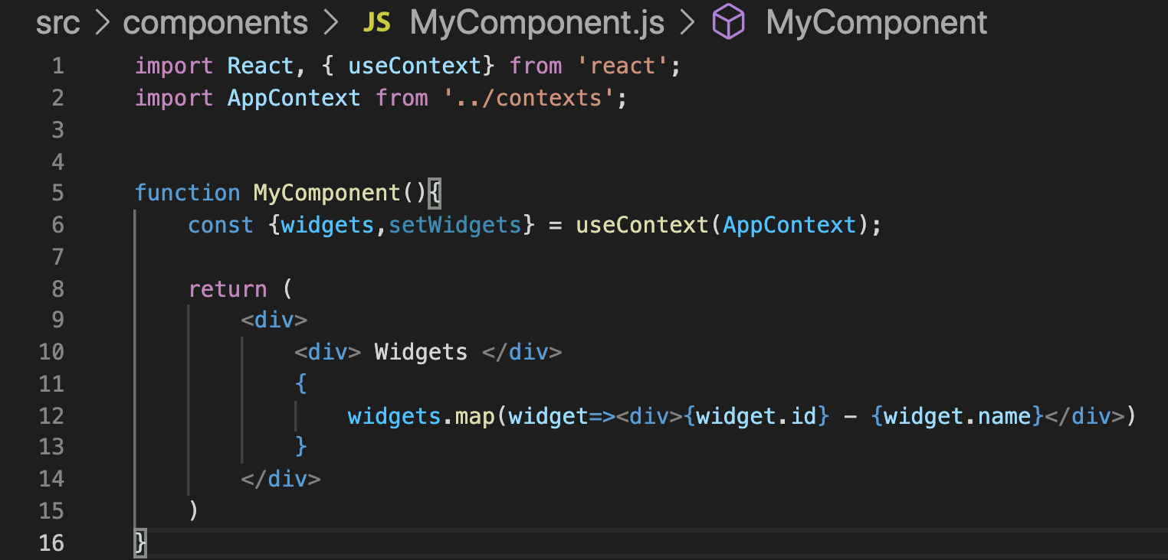
Context
Provide to component or components
Use useContext to extract context locally
https://reactjs.org/docs/context.html

Slide 30
Practice

Slide 31
Code Along Practice – Converting to Hooks
Create context folder with index.js and DeveloperContextProvider.js
Provide to App
Access context from within DisplayBios. Call useEffect to make REST call
Migrate REST call to separate API file

Slide 32
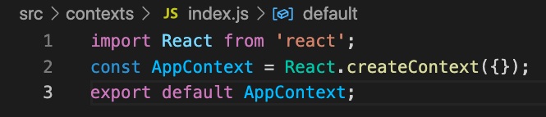
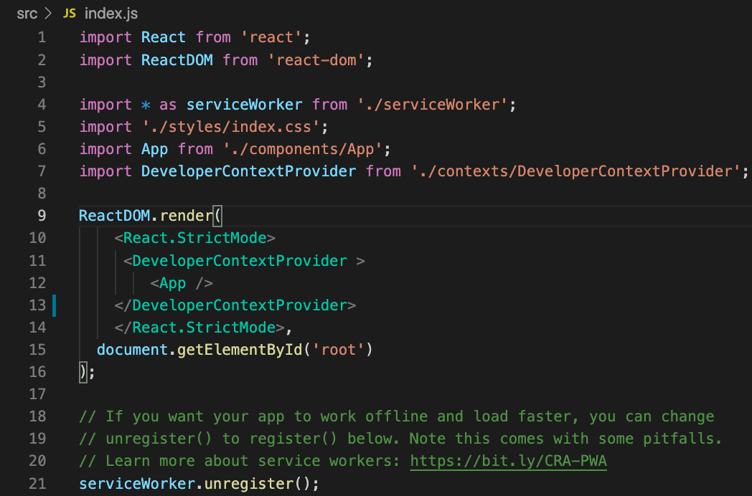
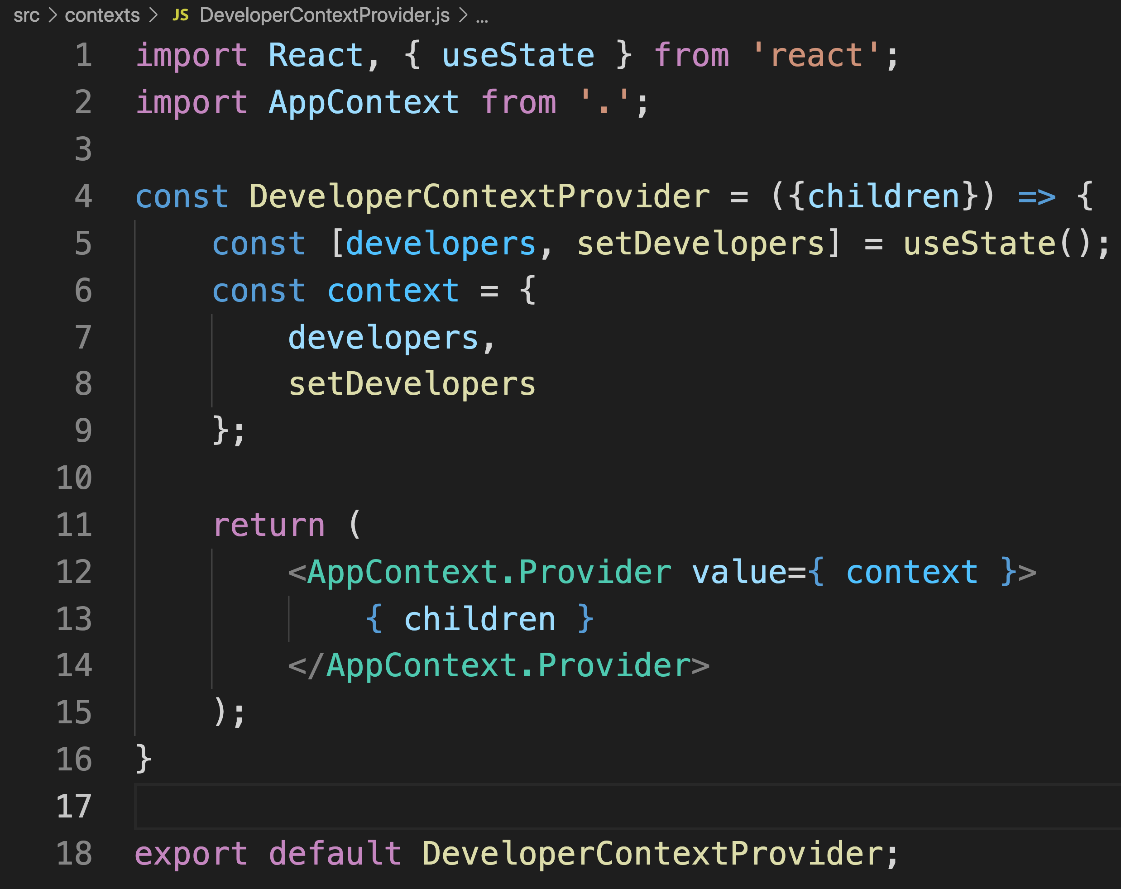
#1 and #2

Slide 33
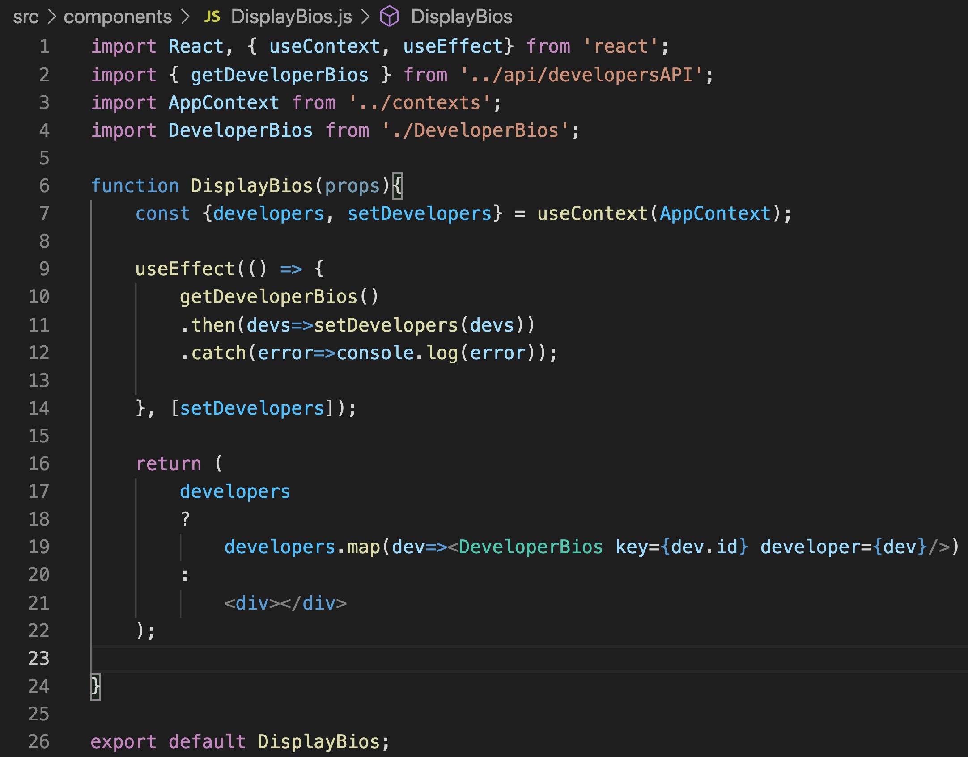
#3

Slide 34
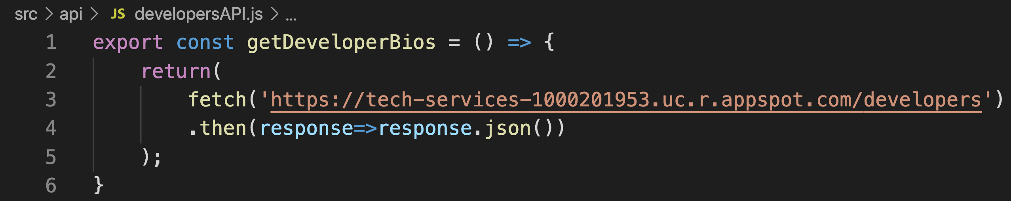
#4

Slide 35
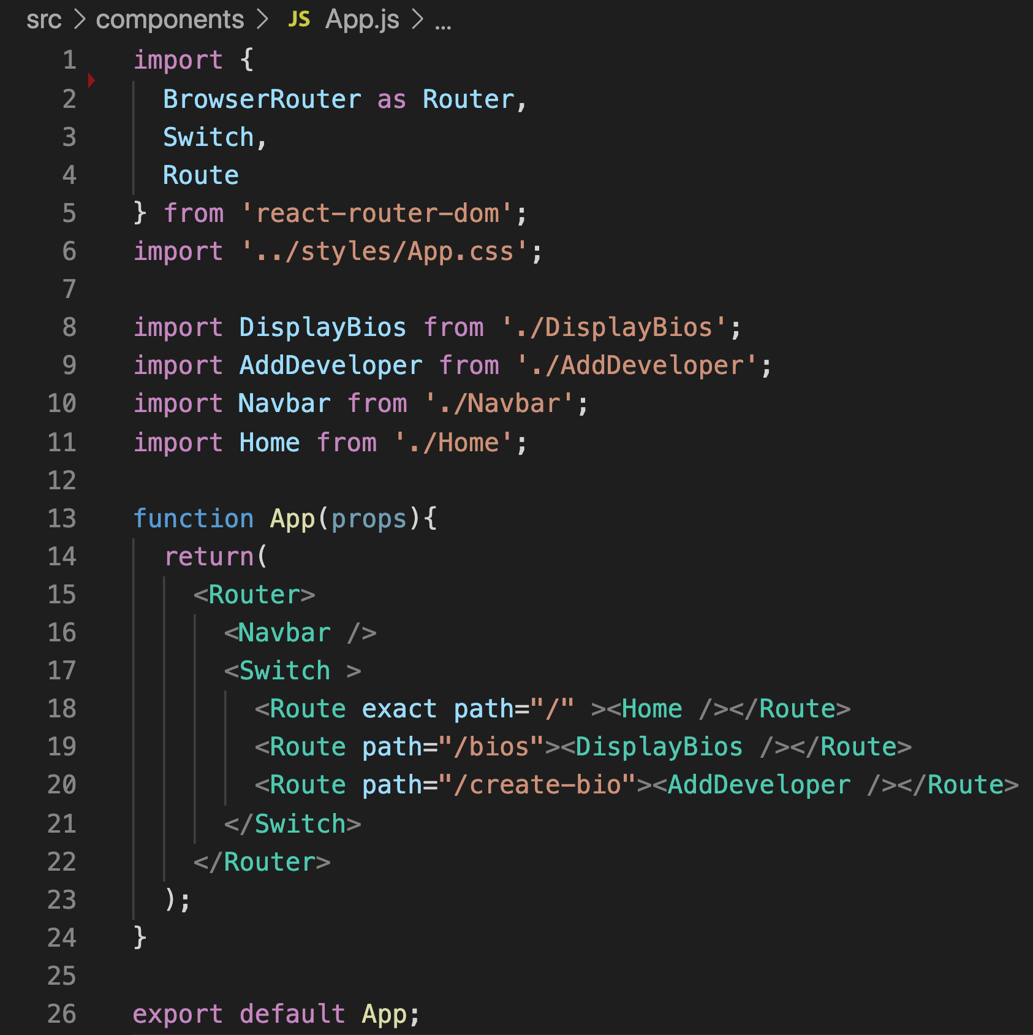
#5

Slide 36
useParams() Router Hook

Slide 37
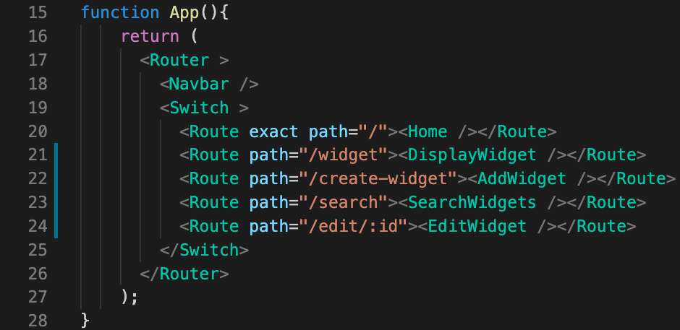
useParams()
Create parameterized route with : syntax
https://reactrouter.com/web/api/Hooks

Slide 38
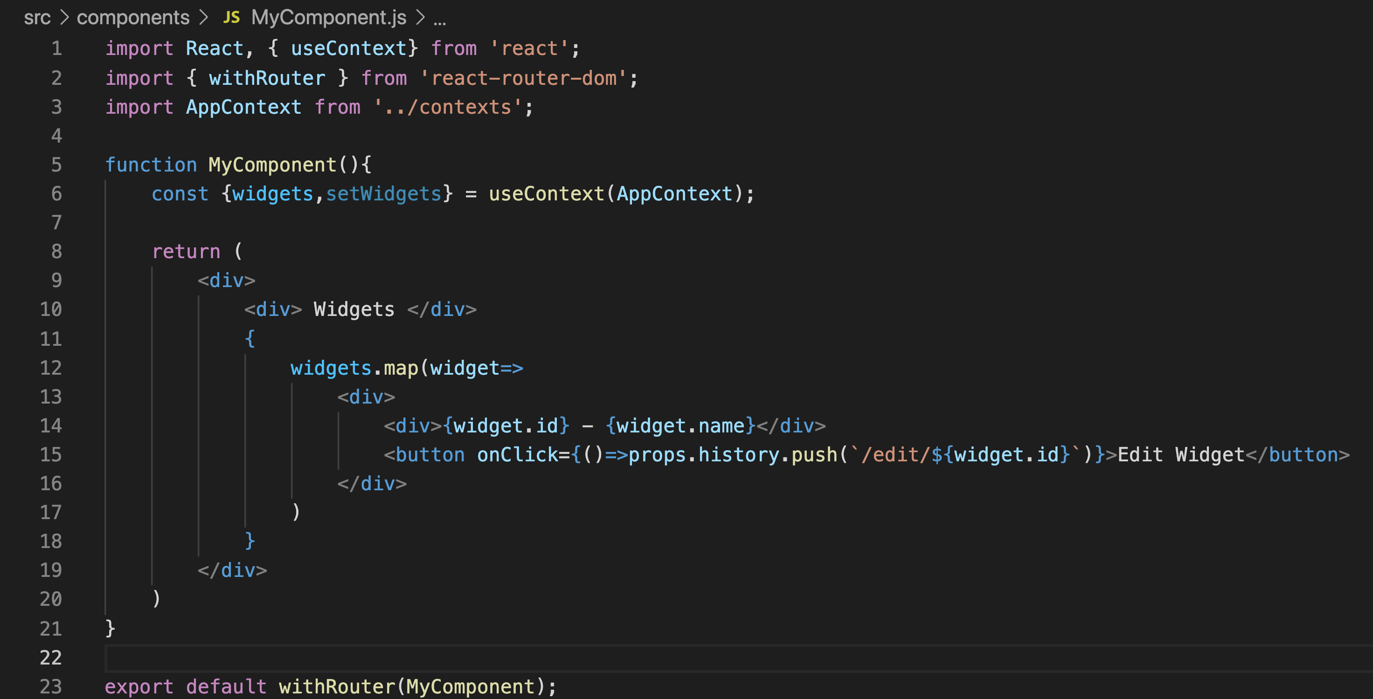
useParams()
Create navigation link
https://reactrouter.com/web/api/Hooks

Slide 39
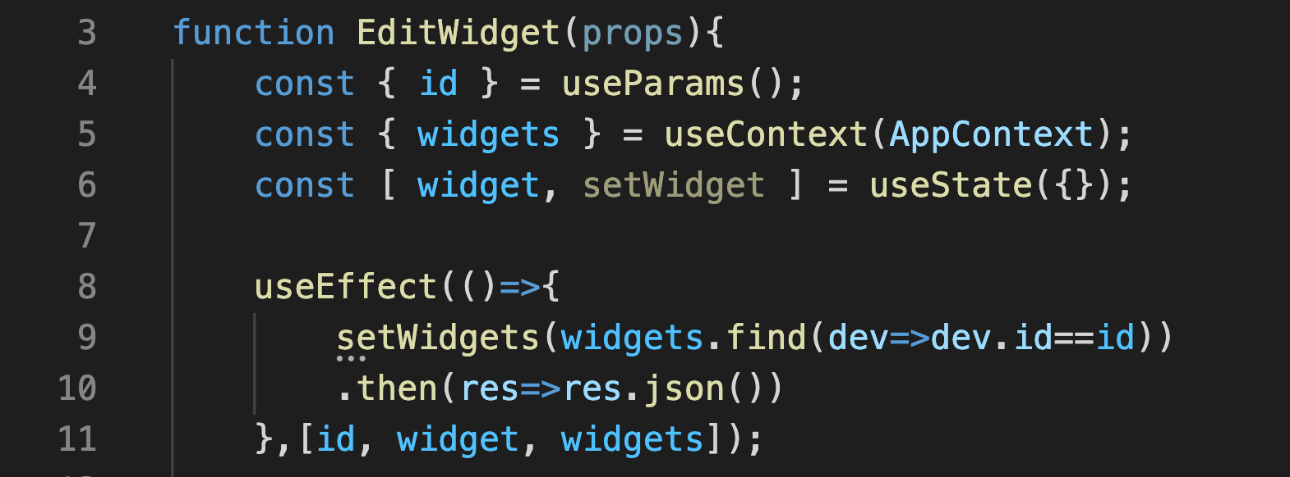
useParams()
Access parameter with useParams()
https://reactrouter.com/web/api/Hooks

Slide 40
Practice

Slide 41
Code Along Practice – Edit Developer Page
Migrate Form to a DeveloperForm functional component.
Update AddDeveloper.js to use DeveloperForm
Send empty dev object
Send event handler that makes POST request
Update DeveloperBio have ‘Edit’ button with parameterized route
Add route to App.js
Create EditDeveloper.js and use DeveloperForm.
Send developer object to be edited
Send event handler that makes PUT request

Slide 42
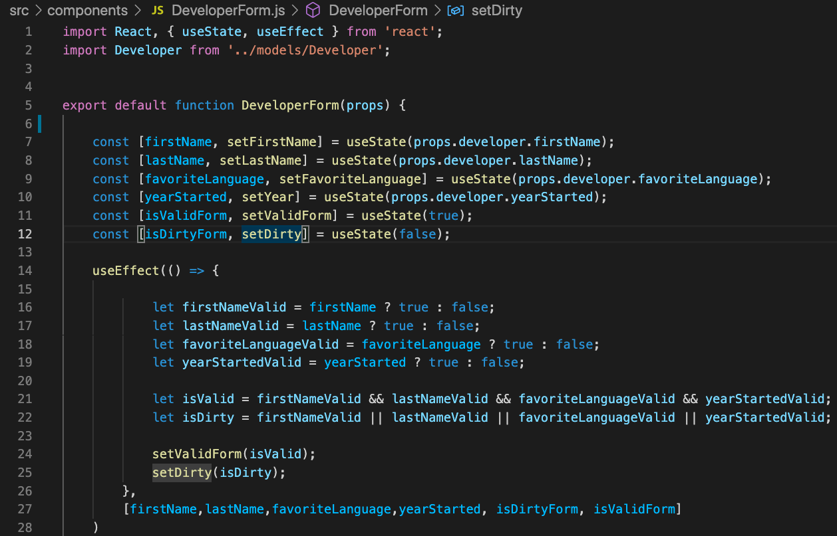
#1

Slide 43
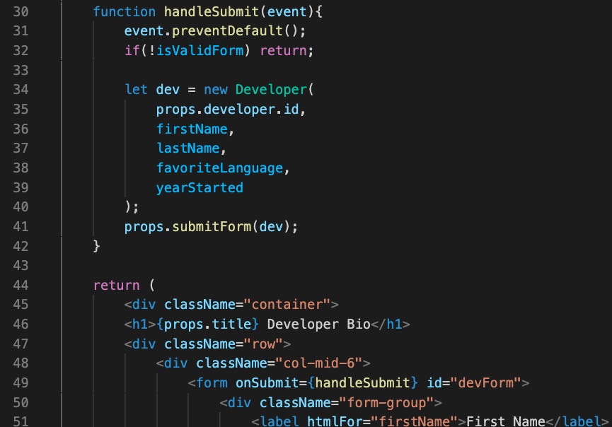
#1 - continued

Slide 44
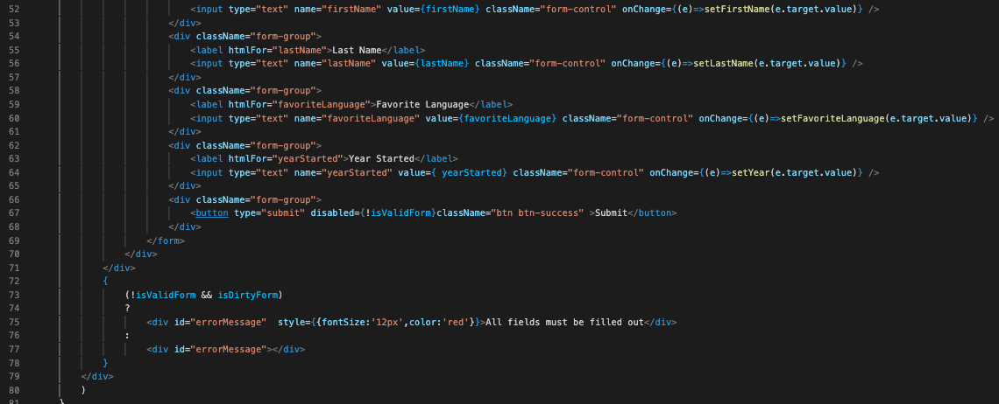
#1 - continued

Slide 45
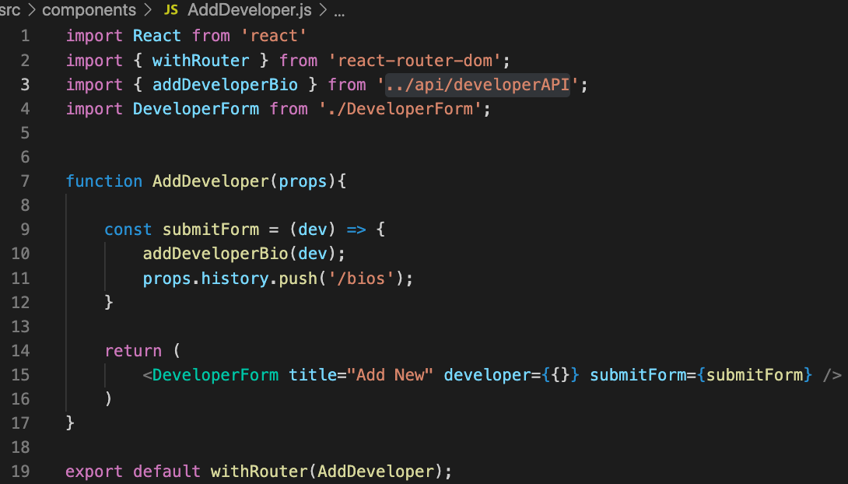
#2

Slide 46
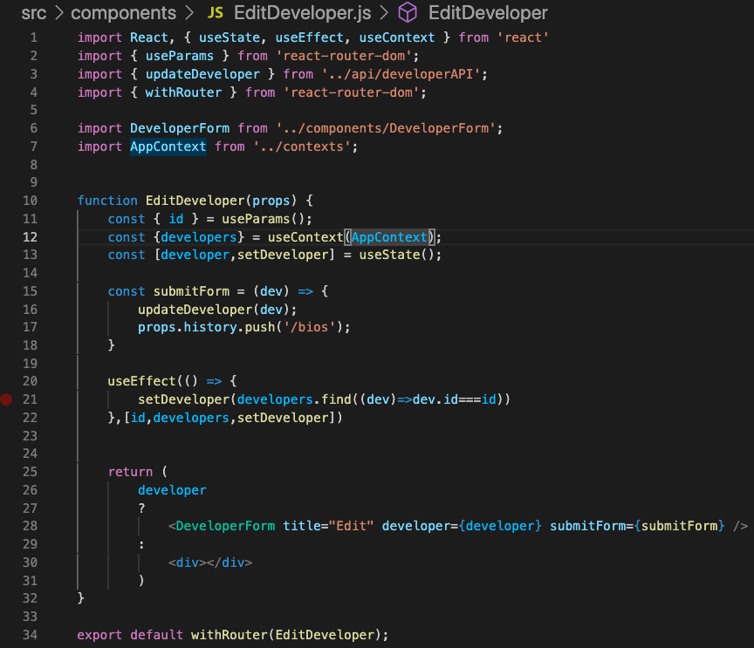
#3

Slide 47
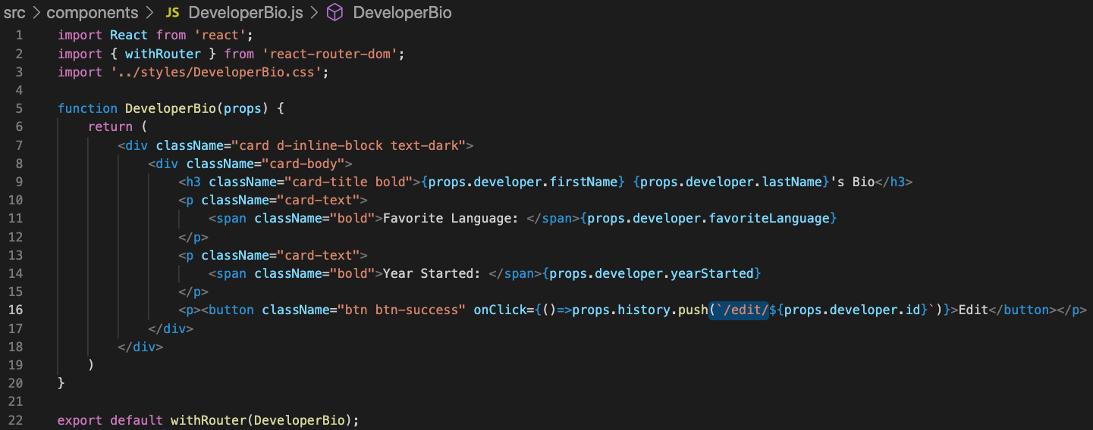
#4

Slide 48
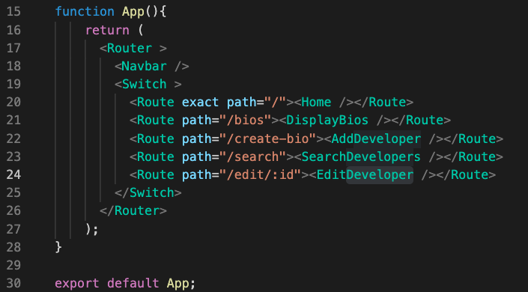
#5

Slide 49
Review

Slide 50
Review
useState
useEffect
Context
createContext
Provider
useContext
useParams

Slide 51
Course Objective:
At the end this 90 min session, you will be able to
Implement React Hooks in a React Application

Slide 52
Does Hooks seem to be better than Redux?
How difficult was it to convert to Hooks?

Slide 53
Thank You

